Slide 1

LIder Ink
Oğuz Burak Üreten
01.03.2016

Slide 2
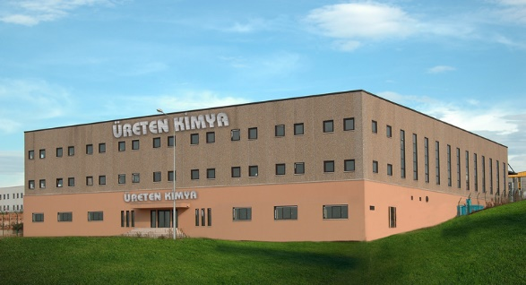
Who are we?
Lider Inks has been established as Lider Kimya Özdemir Üreten in 1983, This privately owned company was producing PVC sealing compounds for Crown caps and twist off caps.
In 1986 our firm started to carry out its function as a joint stock company under the name of Ureten Kimya.
As the first and the only company to produce cap seals in Turkey, Ureten Kimya quickly grown into the market leader in this sector.
The products include PVC Sealing Compounds, Expanded Polyethylene Sheets and PVC-Free Granulates.
The company’s Total annual sales of cap seals has reached 700 Tonnes for Twist Off Caps and 650 Tonnes for PVC Free Granulates.

Slide 3
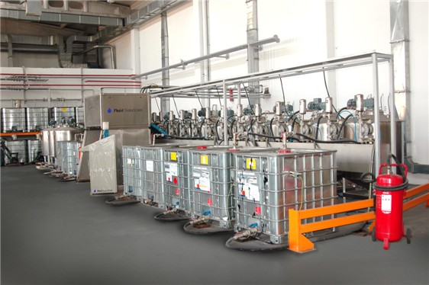
Who are we?
In 1989 we started to producing Cold seal, Heat seal and lacquers
In 1996 Ureten Kimya had enriched its product range by finally printing inks.
We started our path in producing printing inks with one drais brand pearl mill, then with the increasing demand from the market, two extra Netzsch brand pearl mills are purchased
With our increasing success and market share led us to buy 3 extra pearl mills in the following years; In 2004 we got our dispensing system from Fluid solutions (24 Heads).
In 2004 we separated our ink production by moving this division to our new factory which is located right next to our old factory.

Slide 4
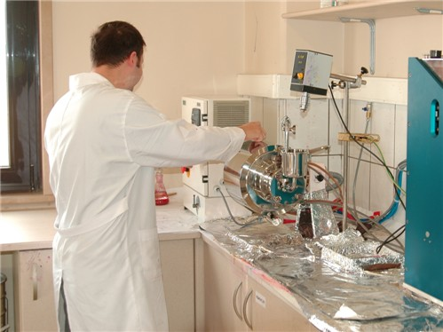
Who are we?
This new purpose built factory had an enclosed area of 4720 m2 with a 1000m2 of office area was designed in the latest fashion to be the perfect ink factory with meeting all the regulations of fire safe and safety engineering.
All of this new investments had moved us to the second position in Turkish market right behind of Bakim (Now Sun Chemical). We were also really active in the surrounding markets of Ukraine, Bulgaria and Iran, we are the first company to ever sell printing inks in Iran.

Slide 5
Who are we?
Our Products include,
Betapol: Flexo / gravure inks with high color strength for front side print. Substrates: PE, Paper
Betalam: Flexo/ gravure inks for lamination and front side print. Substrates: Plain OPP, Metalized OPP, Pearlized OPP, Coex OPP, Paper.
Betapet: High performance gravure inks for PET substrates.
Primer Lacquers, Pre-print Lacquers for flexible packaging
Cold Seal Adhesives: Suitable for flexible packaging industry for laminated or non-laminated films.
Relase Lacquers: Suitable for flexible packaging industry to seal Aluminum to PVC,PS, PR PP, laminated OPP / PVC TO PS

Slide 7
HEAT SEAL
Some of our Heat Seal Lacquers include
HS2000 is applied on Al. Foil to PS and PVC
HS2002 is applied on Al. Foil to seal PVC for blisters
HS3065 is applied on AL.foil or Pet to seal on PP,PS,PVC without a primer
HS3900 is a universal lacquer that can be applied on Al.Foil or PET to seal PP,PS,PVC and PET

Slide 9
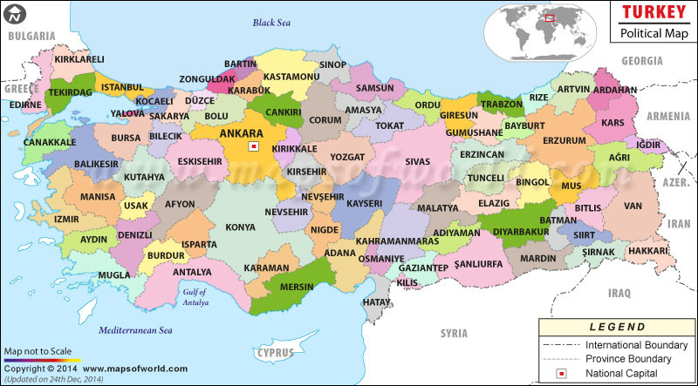
TURKEY
Turkey's location at the crossroads of Europe and Asia makes it a country of significant geostrategic importance.
Has a population of 76,667,864 people.
Turkey has a nominal GDP of $820.827 billion, and the per capita GDP is $11,277
Turkey has a average GDP growth rate of 5.3% between the years 2002-2015
The main export partner is Germany with 8.6 % share in total exports of $167.60 billion.
The economists have a forecast that Turkish economy will keep growing in the following years predicts an average growth rate of 6.7% between the years 2013-2017

Slide 10
Gebze / Kocaeli
Lider Matbaa Mürekkepleri is located in Gebze/ Kocaeli, G.O.S.B..
The metropolitan area of Istanbul extends to the Kocaeli-Istanbul provincial border.
The size and natural conditions of the Bay of İzmit allow for extensive port facilities.
The province is called the industrial capital of Turkey.
Firms like P&G, Unilever, BASF, Carrier, Ford, Mercedes and many other national and international firms have their production facilities in Kocaeli.
Gebze’s proximity to İstanbul and ports make her a very suitable place for investment.

Slide 11
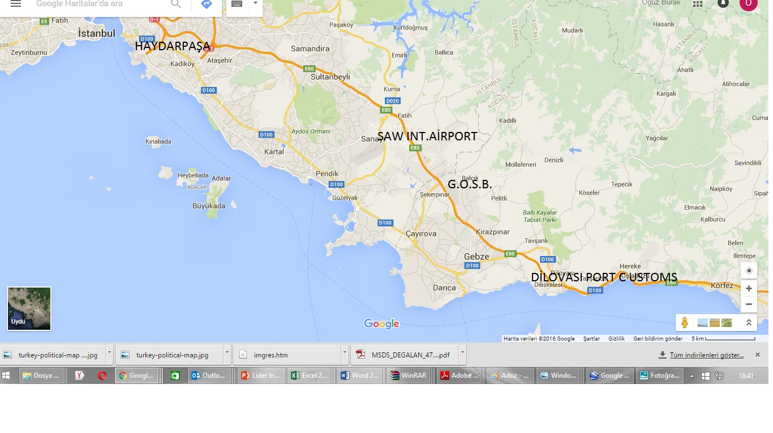
GEBZE / KOCAELİ

Slide 12
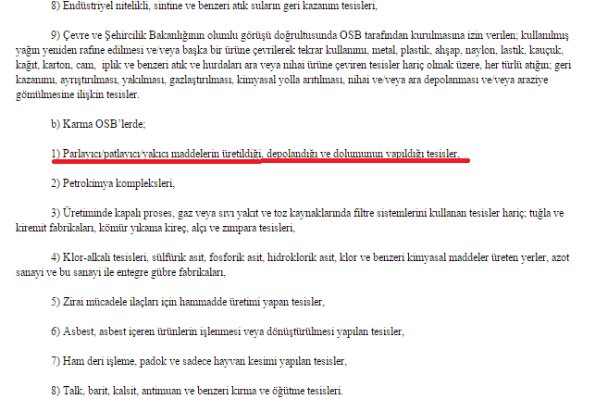
Productıon lıcence
According to Organised Industrial areas regulation Topic 101 b) of The Science, Industry and Technology Ministry published in 2012:
In mix use organized industrial areas such as G.O.S.B. facilities that store, produce or fill flammable, expolosive Chemicals cannot exist.
These kind facilities can be built only on specialized pre-designated industrial areas.

Slide 14
THANK YOU FOR YOUR ATTENTION
Oğuz Burak Üreten
01.03.2016

